Slide 1
JARISCHNELL
🐱‍🏍

Slide 2
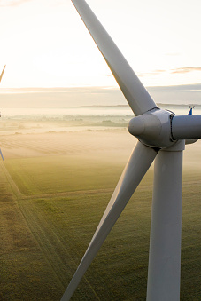
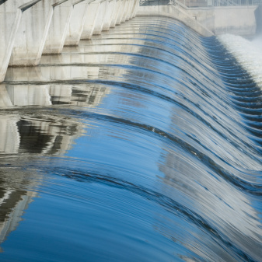
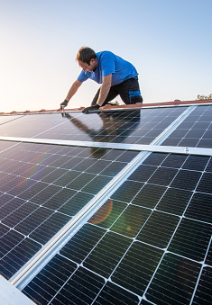
Solving climate change should be a piece of cake
Wind Turbines
Hydroelectric Powerplants
Photovoltaic Panels

Slide 3
Do we actually want to be sustainable?
Effort / Sacrifice
Motivation
No Fun

Slide 4
Problem
People don’t know how to save electricity because they don’t want to know.
How can we motivate the users to save electricity? So that they want to learn how to save electricity.

Slide 5


Hooked by Nir Eyal
Investment
Trigger
Reward
Action
Notes:
https://www.amazon.de/Hooked-How-Build-Habit-Forming-Products/dp/0241184835/ref=asc_df_0241184835/?tag=googshopde-21&linkCode=df0&hvadid=310735773806&hvpos=&hvnetw=g&hvrand=17837759768556426018&hvpone=&hvptwo=&hvqmt=&hvdev=c&hvdvcmdl=&hvlocint=&hvlocphy=1003293&hvtargid=pla-348151187260&psc=1&th=1&psc=1&tag=&ref=&adgrpid=59941302697&hvpone=&hvptwo=&hvadid=310735773806&hvpos=&hvnetw=g&hvrand=17837759768556426018&hvqmt=&hvdev=c&hvdvcmdl=&hvlocint=&hvlocphy=1003293&hvtargid=pla-348151187260

Slide 6

Model for Jari Schnell
Investment:
Challenge
Trigger:
Notification
🐱‍👤
Reward:
Badges
Action:
Link to Feed
Notes:
https://www.amazon.de/Hooked-How-Build-Habit-Forming-Products/dp/0241184835/ref=asc_df_0241184835/?tag=googshopde-21&linkCode=df0&hvadid=310735773806&hvpos=&hvnetw=g&hvrand=17837759768556426018&hvpone=&hvptwo=&hvqmt=&hvdev=c&hvdvcmdl=&hvlocint=&hvlocphy=1003293&hvtargid=pla-348151187260&psc=1&th=1&psc=1&tag=&ref=&adgrpid=59941302697&hvpone=&hvptwo=&hvadid=310735773806&hvpos=&hvnetw=g&hvrand=17837759768556426018&hvqmt=&hvdev=c&hvdvcmdl=&hvlocint=&hvlocphy=1003293&hvtargid=pla-348151187260

